Slide 1
Using Humour in the English Classroom
Ilme Pesur

Slide 2
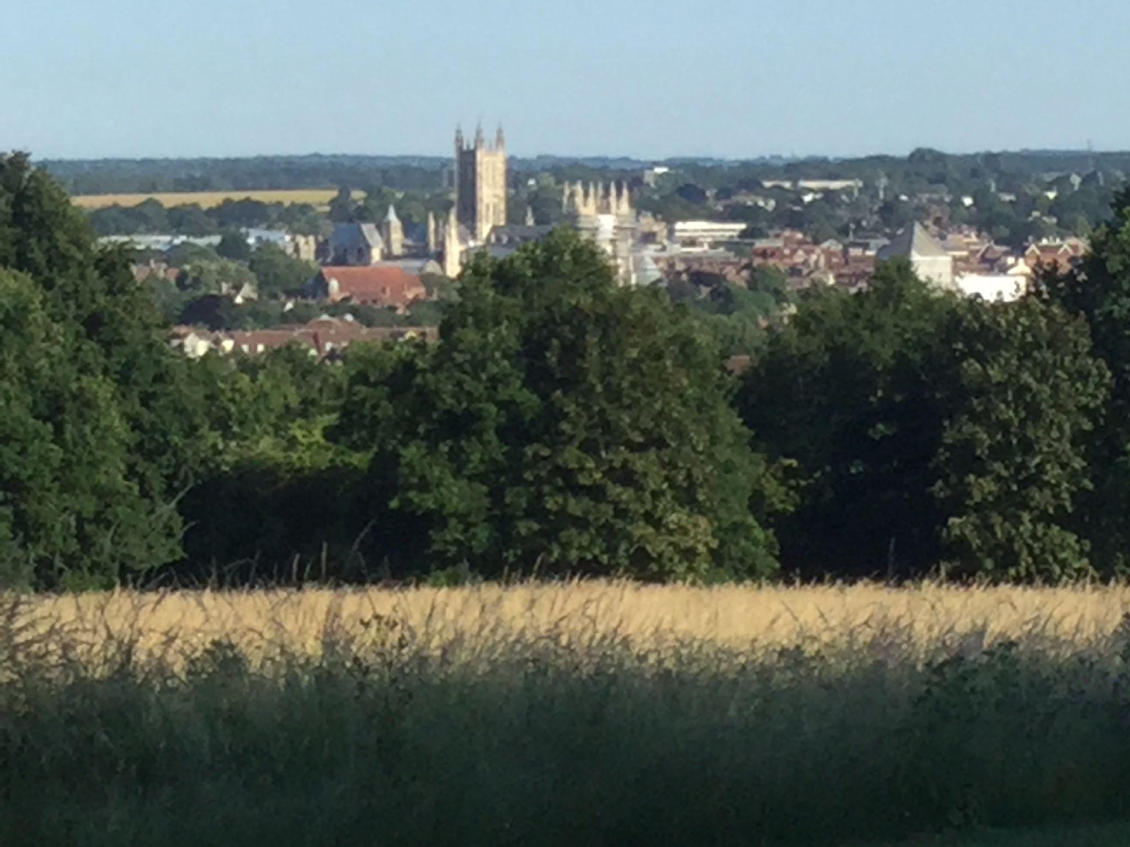

Slide 3
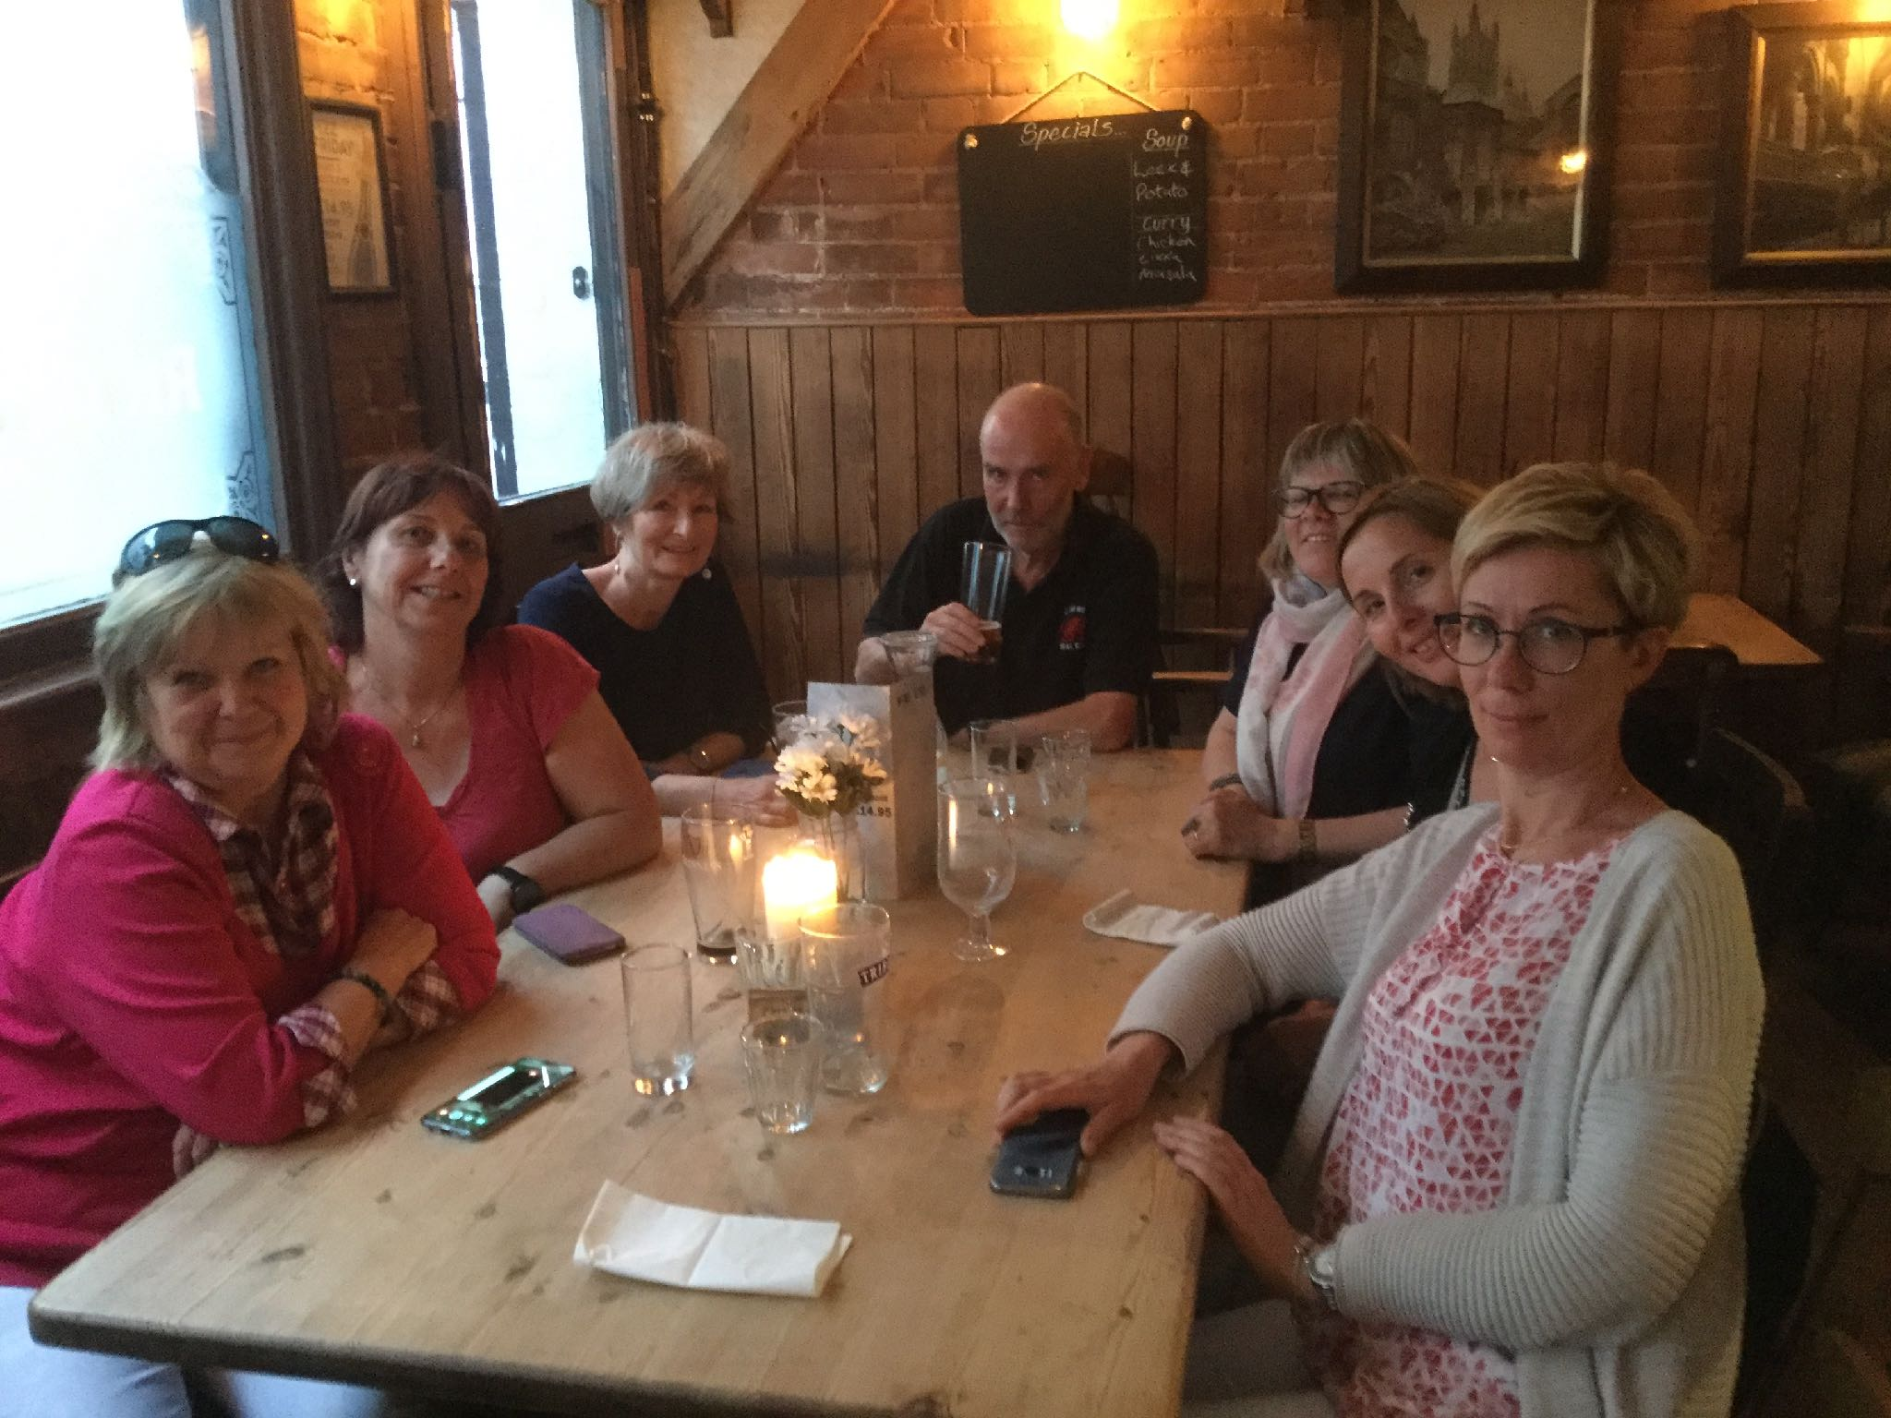

Slide 4
Important person. Important year
Who would you like to interview. Favourite month
Your name
Best place. What can you do well
Where would you like to go? What would you like to
do better?

Slide 5
Pigs might Fly
In random order take words out and make a story - then read the real story
Guide dog. Pig
Three sears. Philadelphia
First class Escaped
Cockpit. Six-hour flight
Seattle Uncontrollable
Stroke. Service animal
Enormous

Slide 6
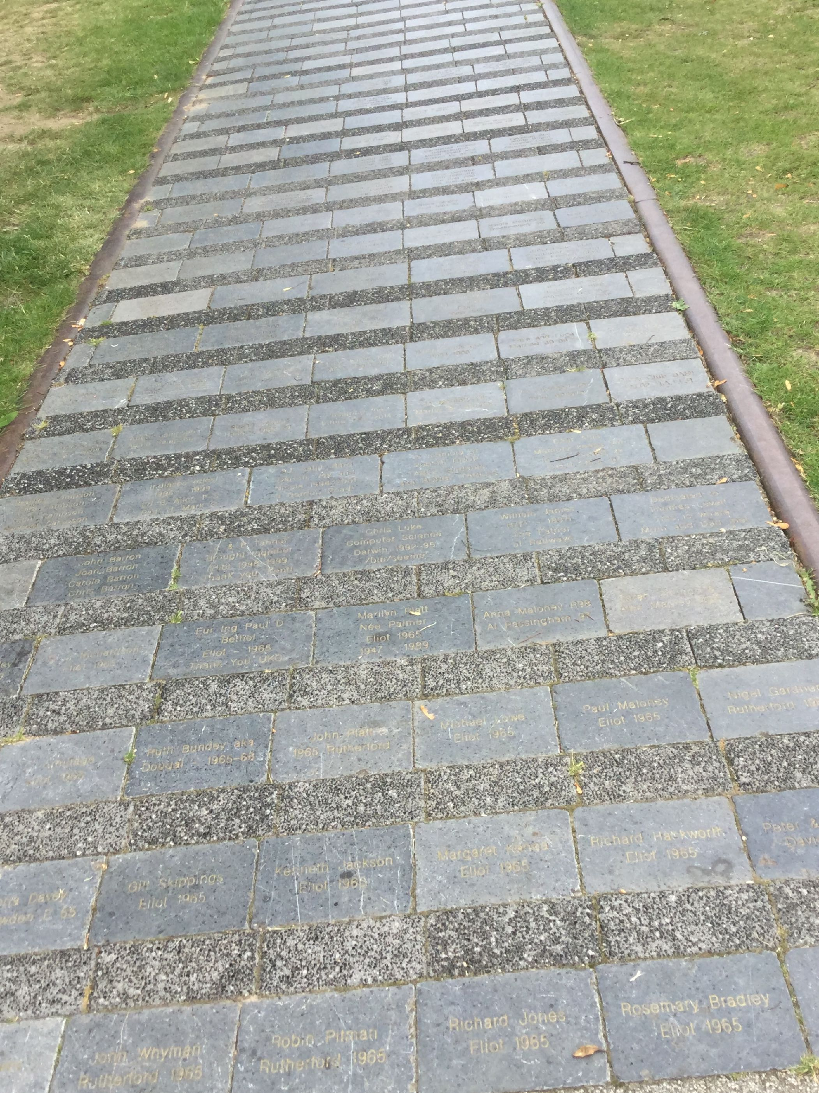


Slide 7
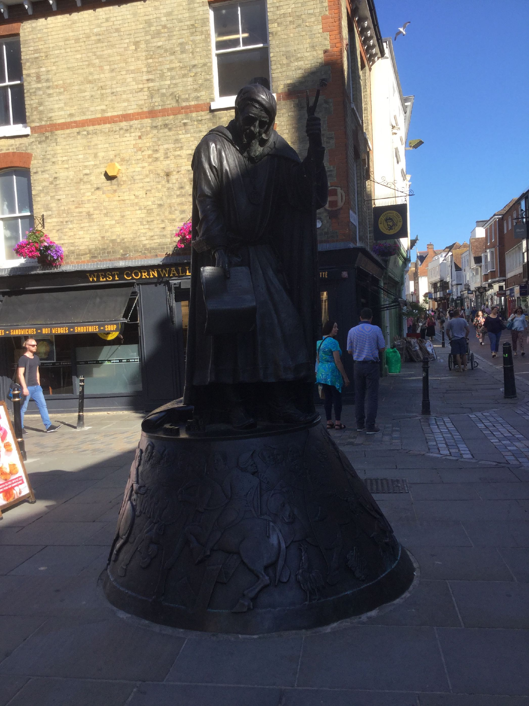

Slide 8
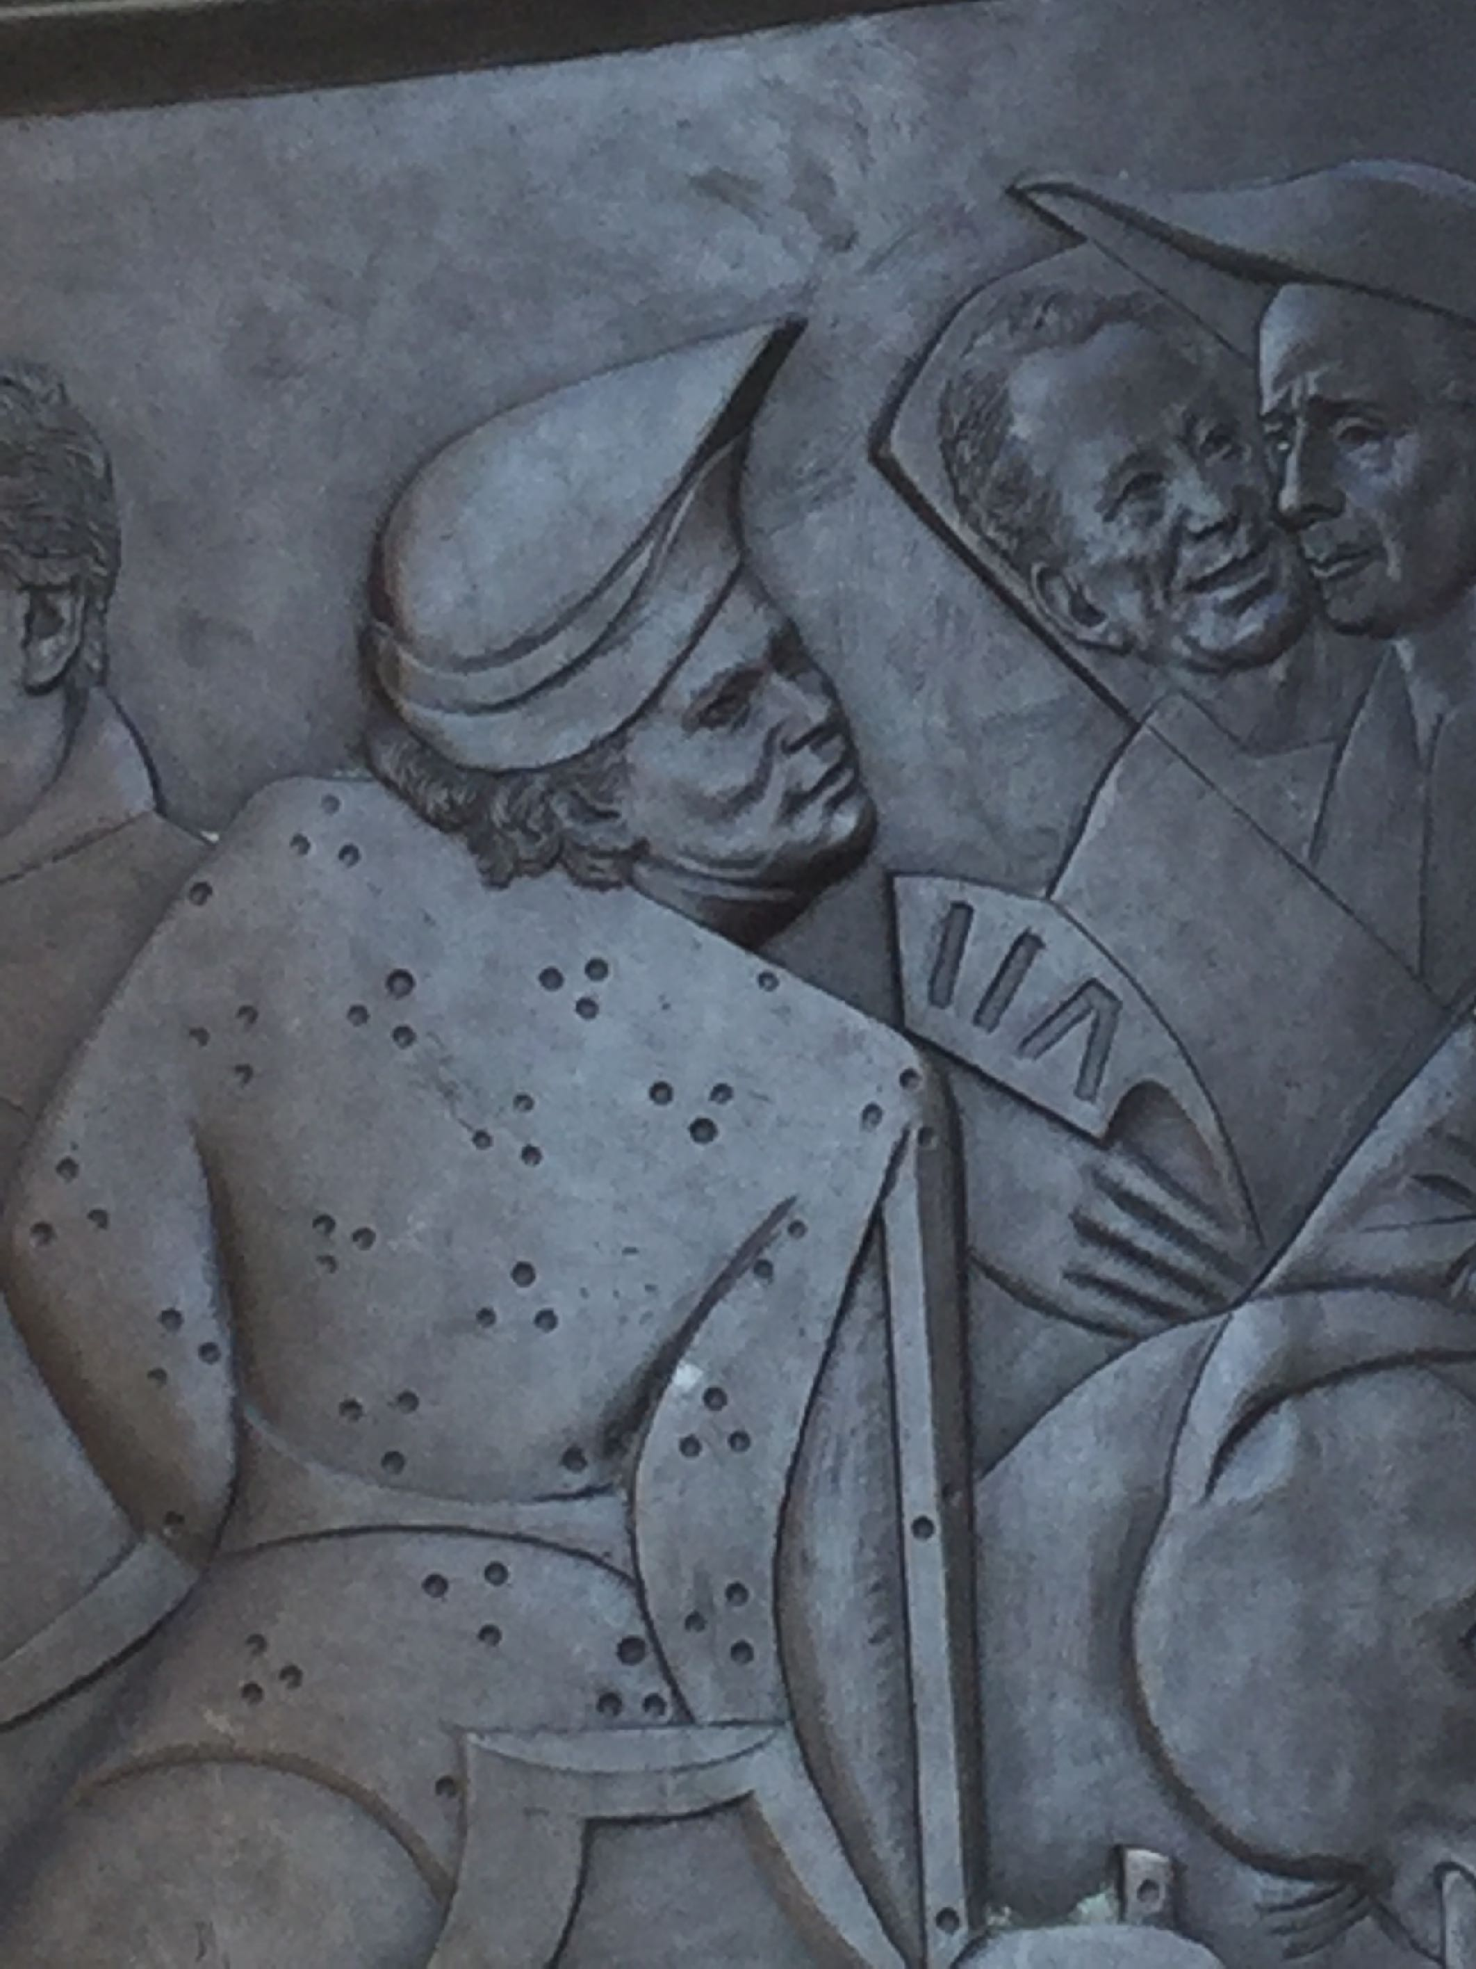

Slide 9
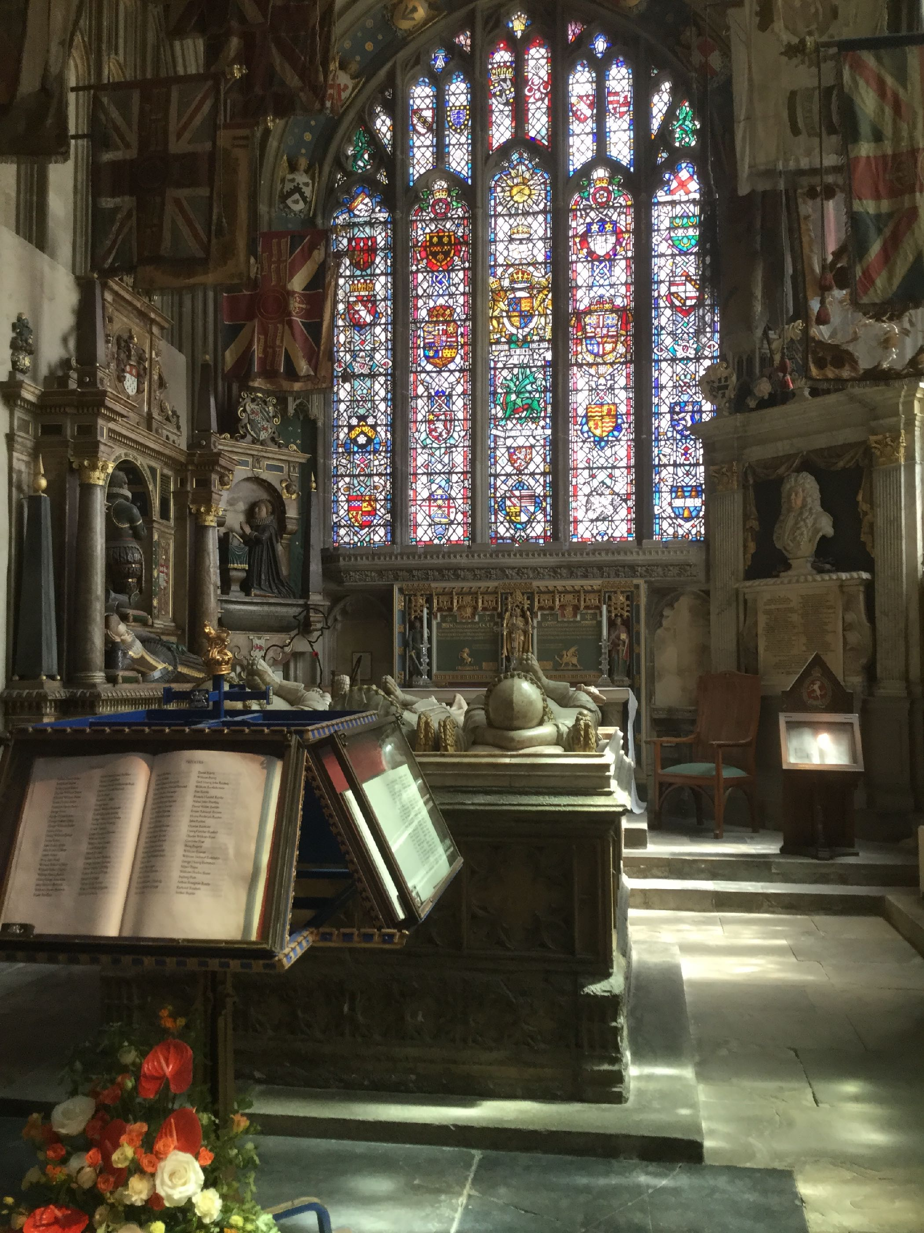

Slide 10
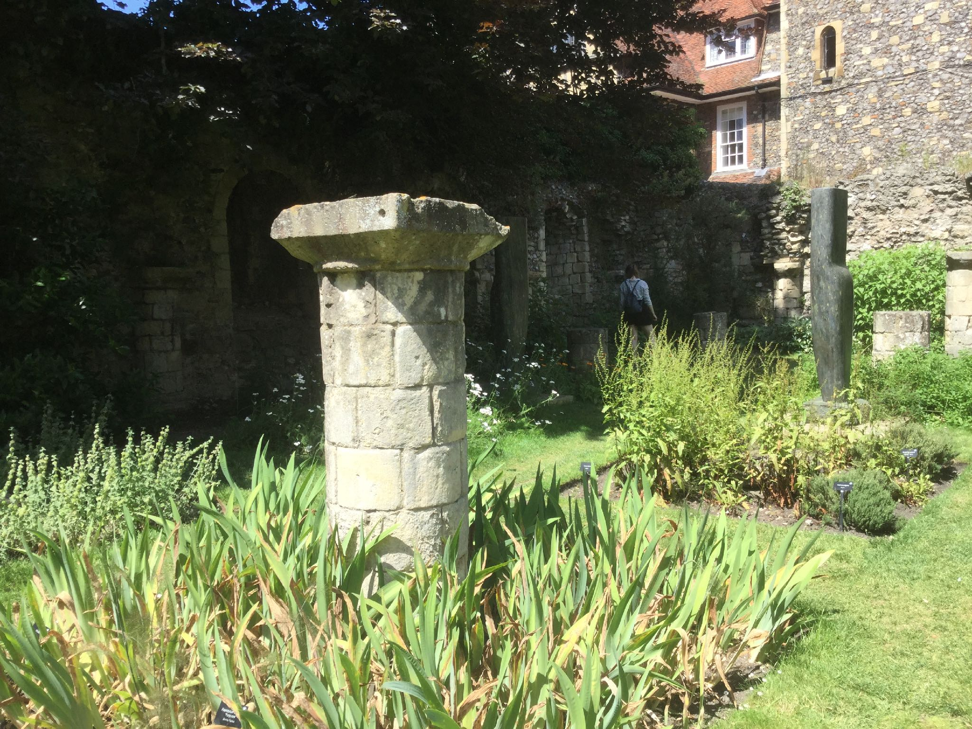

Slide 11


Slide 12
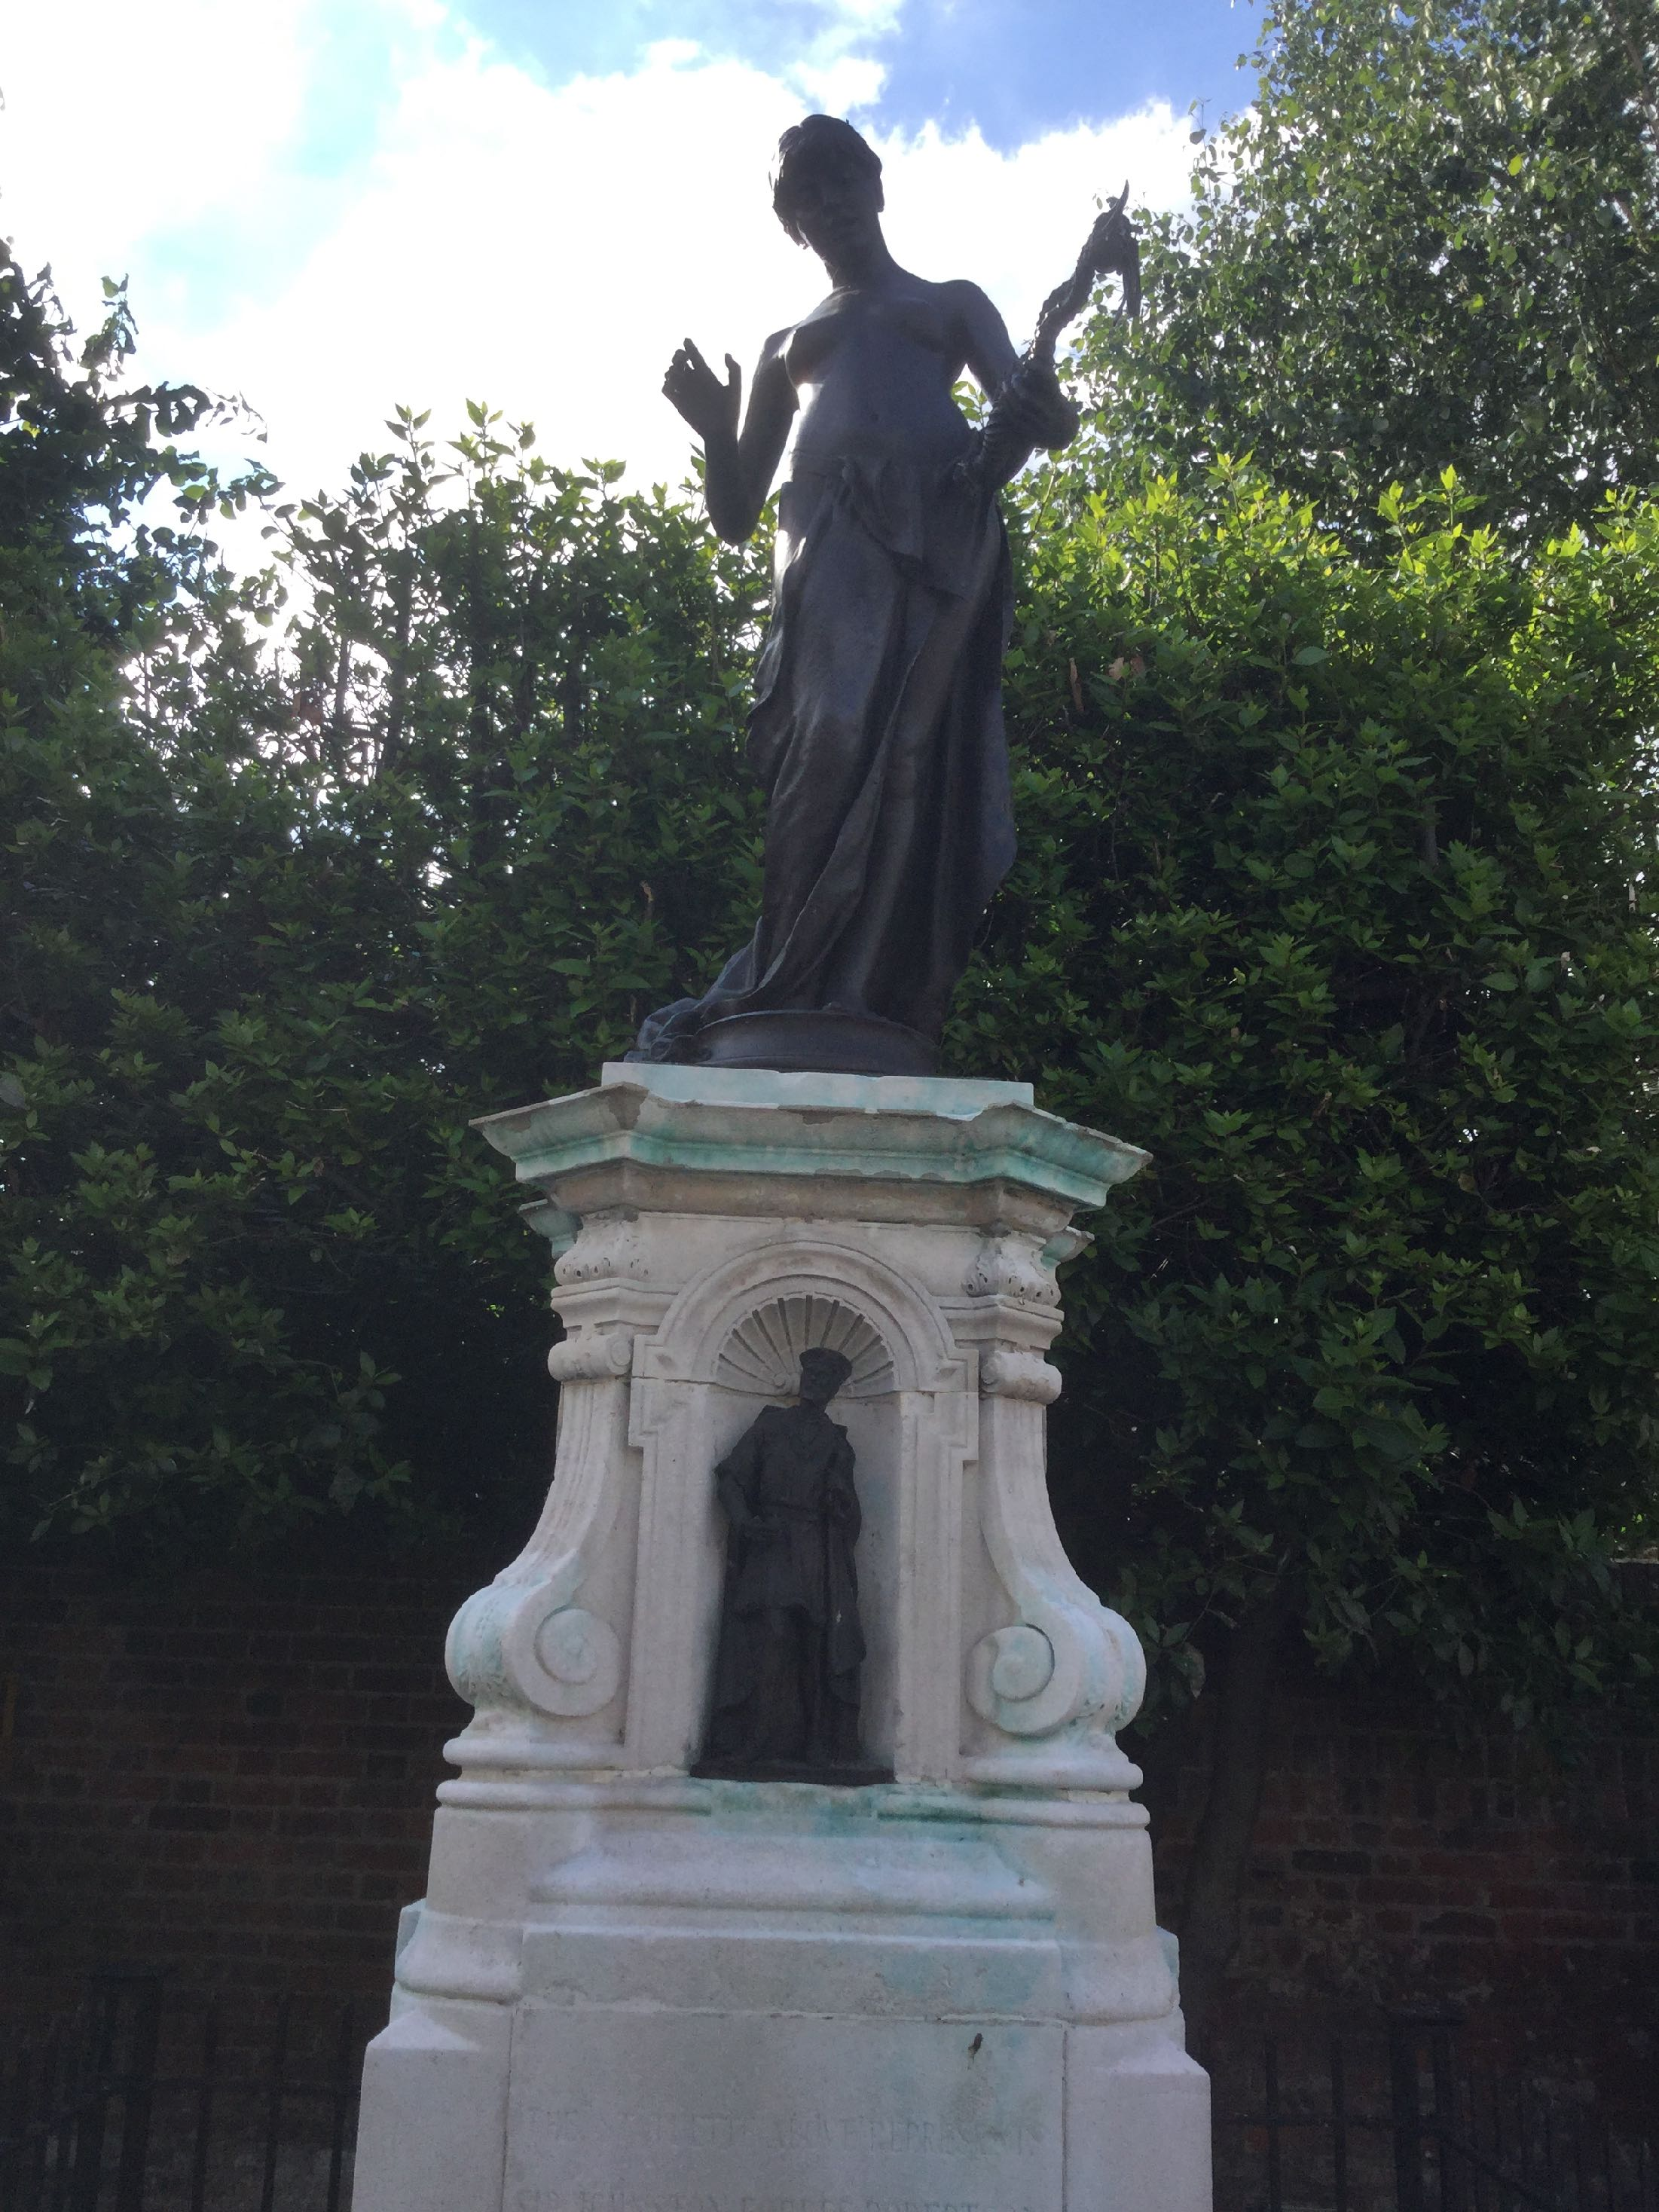

Slide 13
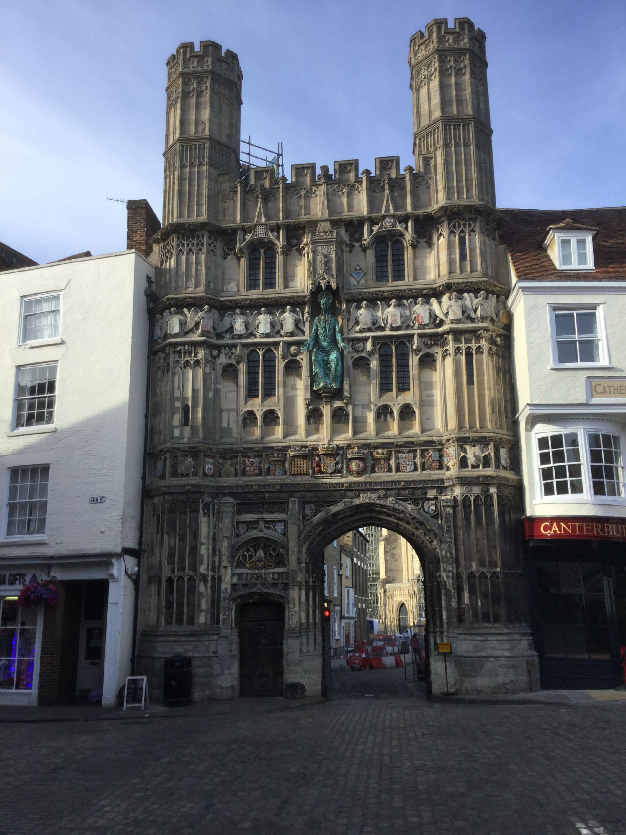

Slide 14


Slide 15
